Slide 1
Employee Data Analysis using Excel
STUDENT NAME : JAYASHREE.D
REGISTER NO : 312209906 (asunm1363312209906)
DEPARTMENT :
COLLEGE : VALLIAMMAL COLLEGE FOR WOMEN
B.COM BANK MANAGEMENT
1
Notes:
1

Slide 2
PROJECT TITLE
Employee Performance Analysis using Excel
2

Slide 3


AGENDA
Problem Statement
Project Overview
End Users
Our Solution and Proposition
Dataset Description
Modelling Approach
Results and Discussion
Conclusion
3/21/2024 Annual Review
3

Slide 4

PROBLEM STATEMENT
. Utilize Excel to efficiently analyse employee data by leveraging
Function such as PIVOT TABLES, and conditional formatting.
. The enables the identification of key trends, such as current
Employees rates, performance levels.
Descion-making processes by visualization this data through Pie chart
4

Slide 5

PROJECT OVERVIEW
.
This project focuses on analysing employee data to identify trends and
And insights that can drive better decision.
Excel will be used to clean, organize, and visualize kry metrics such as
Employee demographics, performance, and rention rates.
The analysis will highlights areas of improvement in workforce management
Helping to optimize resource allocation.
Outcomes will include detailed reports and dashboard for management
Review.
The finding aim to support strategic planning.
5

Slide 6
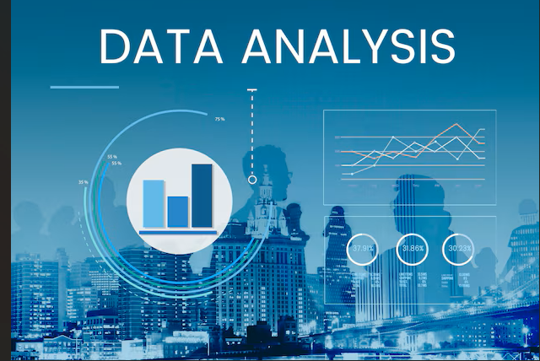

WHO ARE THE END USERS?
The end users of the employee data employee data analysis are HR
Managers team leads and senior management.
6

Slide 7

OUR SOLUTION AND ITS VALUE PROPOSITION
Conditional formatting – highlights missing cells
Filter – helps to remove the empty cells
Formulas – helps to identify the performance of employees
Pivot table – helps summarize
Pie chart – shows the data
7

Slide 8
Dataset Description
1. Employee ID
2. First name
3. Last name
4. Business unit
5. Employee classification type
6. Employee type
7. Gender
8. Performance score
9. Current employee rate
10. Performance level

Slide 9
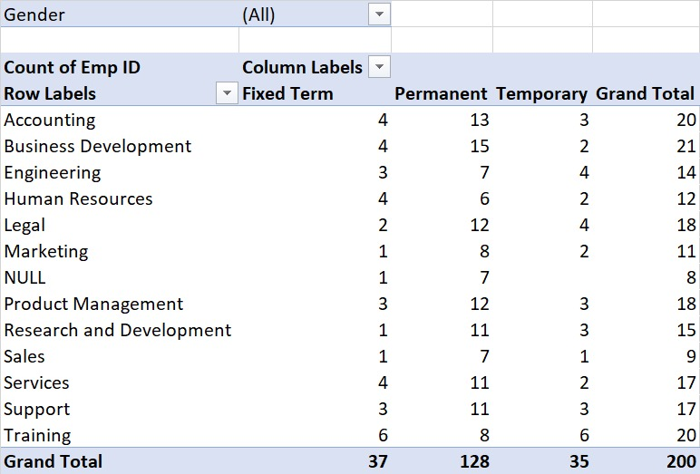

THE "WOW" IN OUR SOLUTION
3/21/2024 Annual Review
9

Slide 10
MODELING
DATA COLLECTION
*Identification
*Gathering
*Preparation
DATA CLEANING
*Standardization dilation
*Correction
*Validation
SUMMARY
Data analysis involves examining, transforming, and modelling data to
Extract insights , identify patterns, and support decisions-making.
10

Slide 11
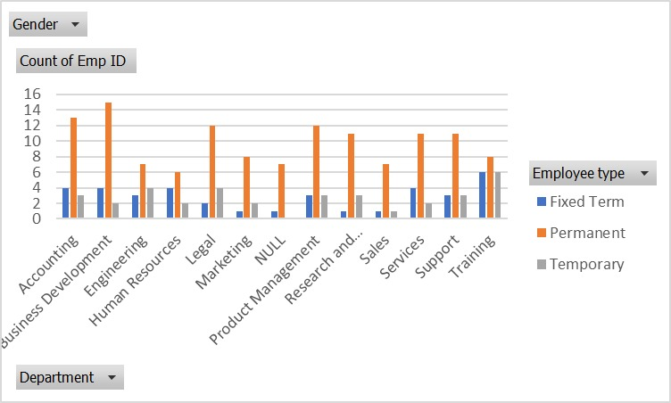
RESULTS
11

Slide 12
conclusion
* IN CONCLUSION, the employee data analysis conducted using Excel
Provided valuable insights into workforce trends enabling more
Informed decision-making.
The use of Excel allowed efficient data organization, visualization
and reporting, ultimately helping to enhance HR strategies, improve
and employee satisfaction and optimize overall organizational
performance.

